Slide 1

Credit Card Data Analysis and Recommendations
Aaron Packard, Mark Foxworth, Alex Waters

Slide 2
Motivation and summary slide
How economic factors influence the Credit Card products that should be offered based on economic conditions.
Four basic questions
Relationship between age, neighborhood income, credit scores compared to cc origination
Relationship between prime rate, personal savings rate, unemployment, cc delinquency and charge off rates
Correlations between economic data and origination activity
Based on economic environment should measures be adopted to increase/decrease originations

Slide 3

Questions and data

Slide 4


Data Sources:

Slide 5

Exploration and clean up process
Unanticipated insights
Problems and solutions
Interesting figures developed during exploration

Slide 6
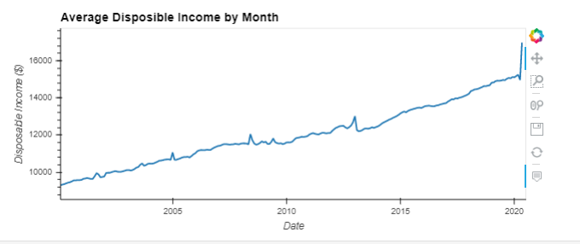
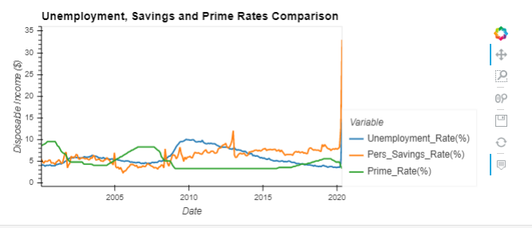
Data analysis

Slide 7
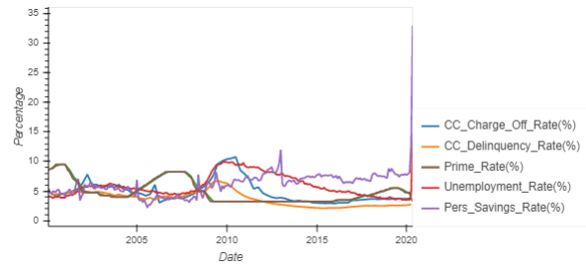

Slide 8

Discussion of Findings

Slide 9


What should we do? Extra sample slide
Make the loan
Sorry no loan

Slide 11


Slide 12
Wrap up issues and outstanding questions

Slide 13

ANY

